Slide 1
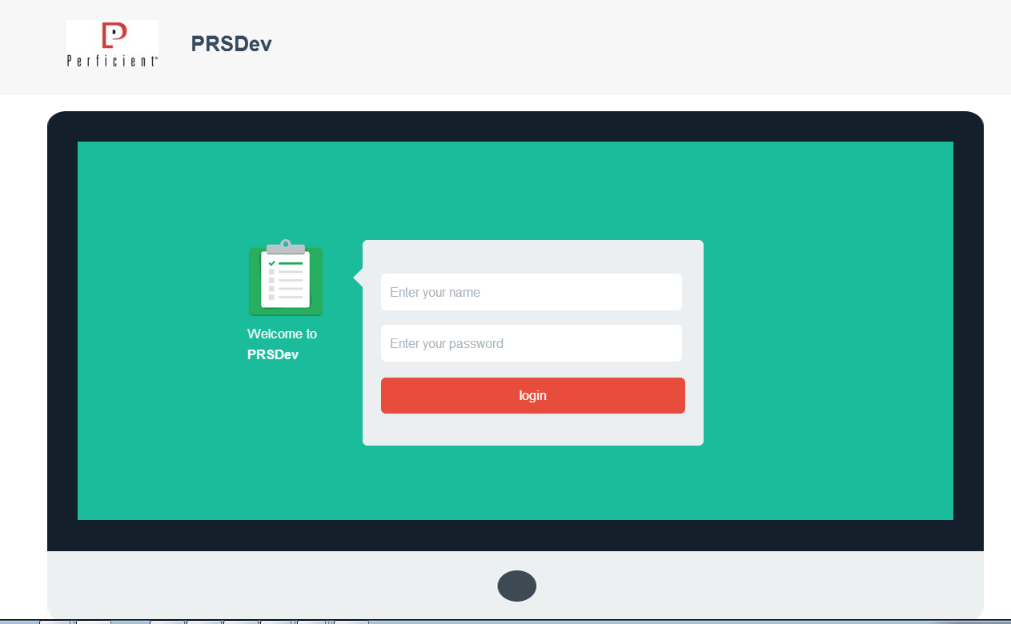
A | Will design and implement a new header – future
B | Remove computer monitor graphic see page layout representation on next screen
A
B

Slide 2
New Header (to be designed)
Content Placeholder
Login Control

Slide 3
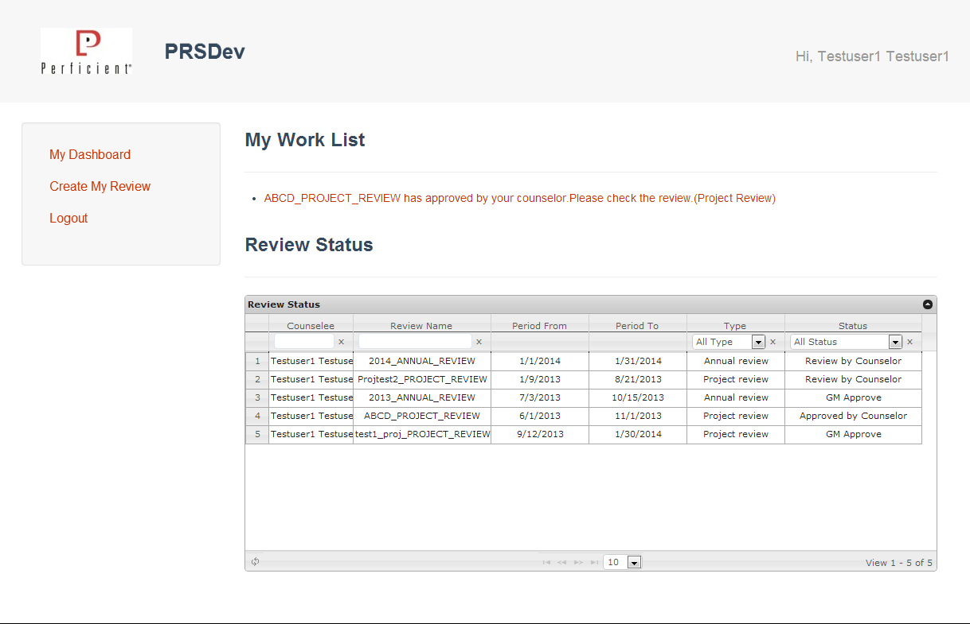
A
A | CHANGE TEXT: Welcome, First Last
B | Display My Work List as a table
C | Change to “In Process Reviews” section
D | Add a “Completed Reviews” section
 | See sample screen layout on next page
B
D
C

Slide 4
Welcome, John Spyers
Logout
My Dashboard | Work a Review | Completed Reviews
My Work List
Review | Status | Action
Project Review | Approved by Counselor | View
Annual Review | Draft | Edit
In Process Reviews
Counselee | Review | Type | Status
Last Name, First Name | Title | Project | Status
Last Name, First Name | Title | Annual | Status

Slide 5
Welcome, John Spyers
Logout
My Dashboard | Work a Review | Completed Reviews
My Completed Reviews
Review | Type | Period
Project Review | Annual | To – From Date
Annual Review | Project | To – From Date
Completed Reviews for Others
Name | Review | Type | Period
Last Name, First Name | Title | Project | To – From Date
Last Name, First Name | Title | Annual | To – From Date

Slide 6
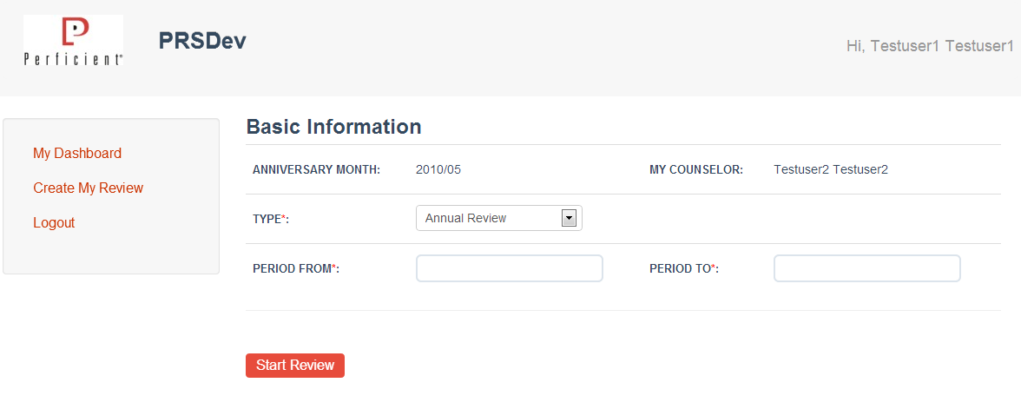
 | See sample screen layout on next page

Slide 7
Welcome, John Spyers
Logout
My Dashboard | Work a Review | Completed Reviews
Review Details
Peer Review Info
Review Details
Basic Information
Anniversary Date: Month / Day / Year
Counselor: First Last
Review Type: <<drop down selector>>
Review Period Start: <<date selector>>
Review Period End: <<date selector>>
Next

Slide 8
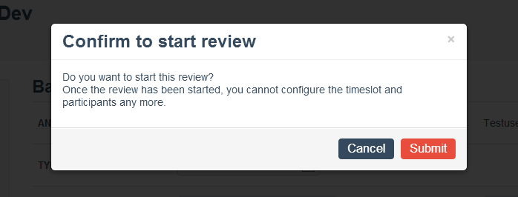
A | Should this appear AFTER selecting peers?
A

Slide 9
Confirmation
Once review is started you can no longer configure the type, time periods or any participants. If changes to these items are required you must begin a new review.
Cancel
Next

Slide 10
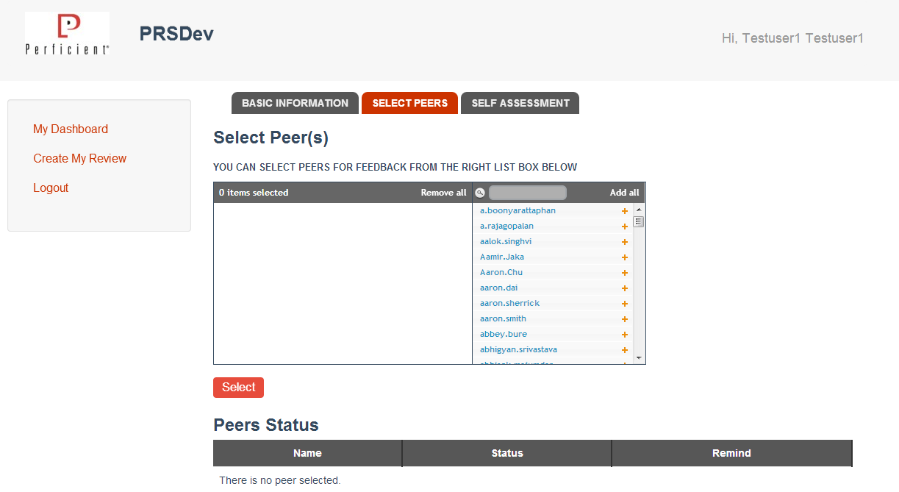

Slide 11
Welcome, John Spyers
Logout
My Dashboard | Work a Review | Completed Reviews
Review Details
Peer Review Info
Review Details
Peer Review Info
Search for Peer:
Peer List
Type ahead peer filtering
Add
Name | Status | Action
First Last | Not Sent | Remove
First Last | Not Sent | Remove
First Last | Not Sent | Remove
Next

Slide 12
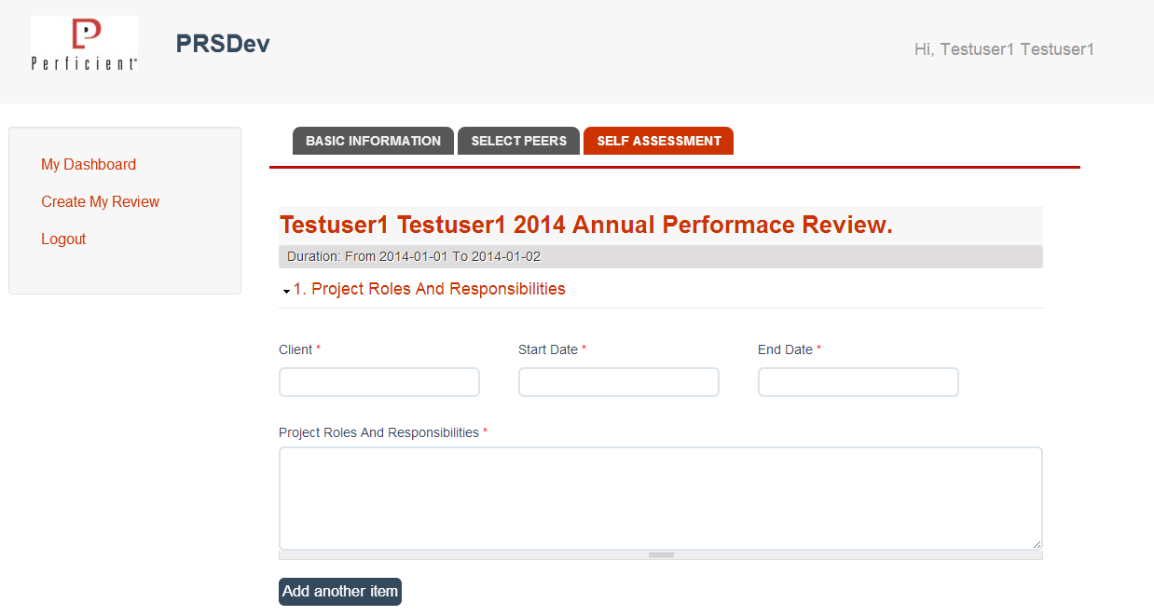

Slide 13
Welcome, John Spyers
Logout
My Dashboard | Work a Review | Completed Reviews
Review Details
Peer Review Info
Review Details
>> Summary
>> Previous Year Goals and Achievements
>> Performance Evaluation
>> Planning Goals
>> Finalize
Review Details - Summary
My Information
Review Type: Annual
Name: First Last
Period: To -- From
Project Roles and Responsibilities
Client: <<text box>>
Project Name: <<text field>>
Start Date: <<date selector>>
End Date: <<date selector>>
Enter roles and responsibilities here…
+ Add Another Project
Next

Slide 14
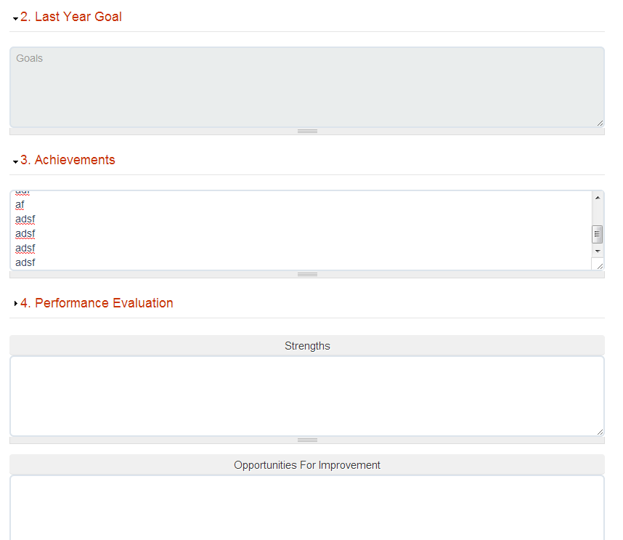
A | Put “Last Year’s Goals” and “Last Year’s Achievements” on an individual intermediary page. Allow “Back”, “Next”, “Save as Draft”
B | Put “Performance Evaluation” on its own page. Allow “Back”, “Next”, “Save as Draft”
C | Put Strengths, Opportunities for Improvement, and Summary on its own page.
A
B
C

Slide 15
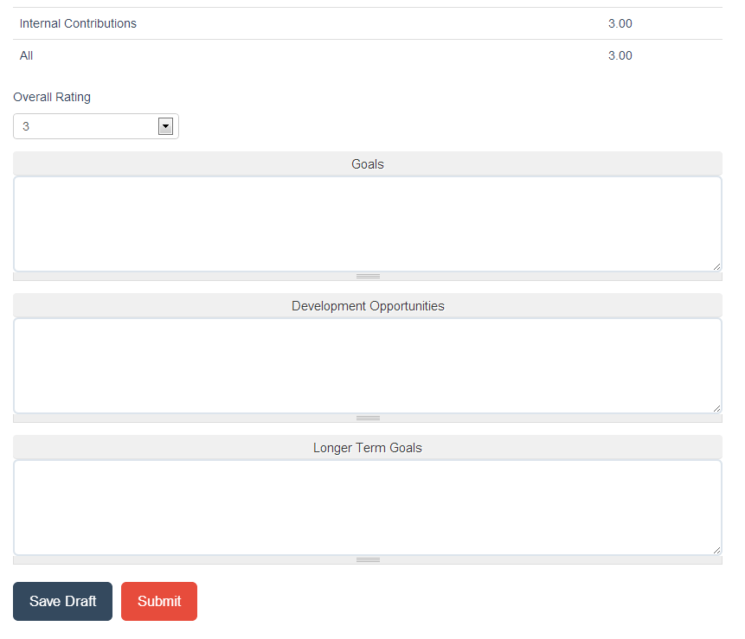
A | Put Goals, Development Opportunities, and Longer Term Goals on a page.
A

Slide 17
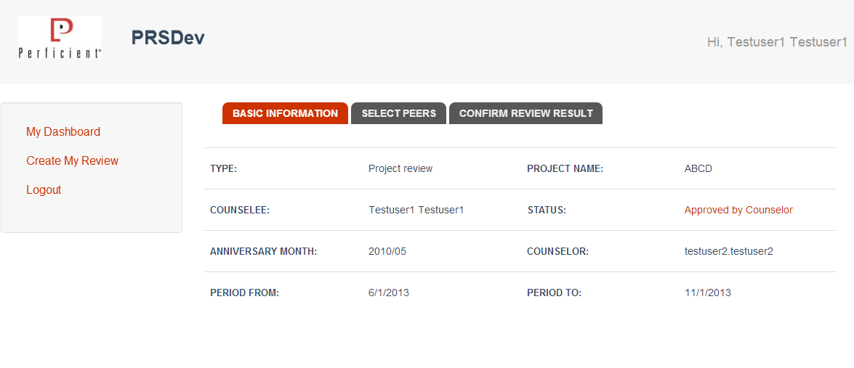

Slide 18
Welcome, John Spyers
Logout
My Dashboard | Work a Review | Completed Reviews
Review Details
Peer Review Info
Review Details
Review Details
Counselee Name: first last
Anniversary Date: month / day / year
Counselor: first last
Review Type: type
Project Name: if necessary
Review Status: Approved by Counselor
Review Period Start: date
Review Period End: date
Next

Slide 19
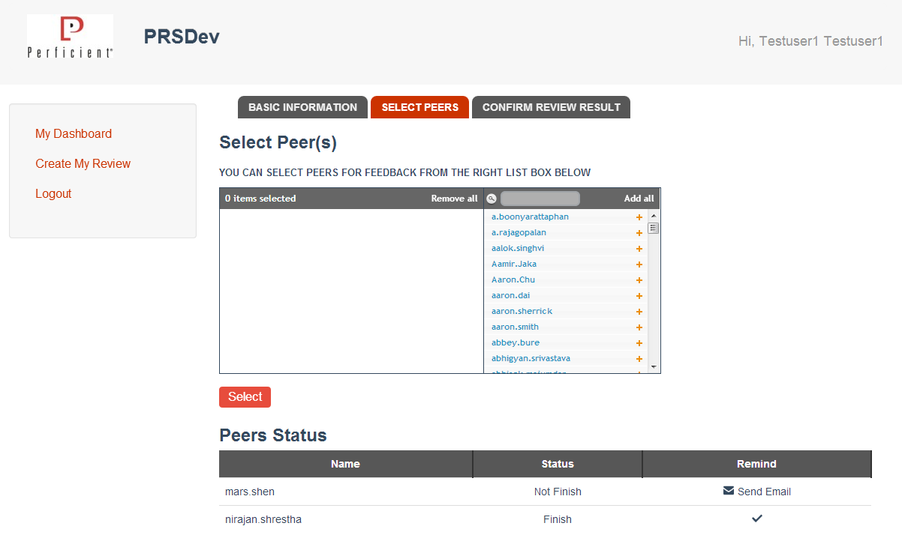

Slide 20
Welcome, John Spyers
Logout
My Dashboard | Work a Review | Completed Reviews
Review Details
Peer Review Info
Review Details
Peer Review Info
Search for Peer:
Peer List
Type ahead peer filtering
Add
Name | Status | Action
First Last | Sent | Remind
First Last | Sent | Remind
First Last | Complete
Next

Slide 21
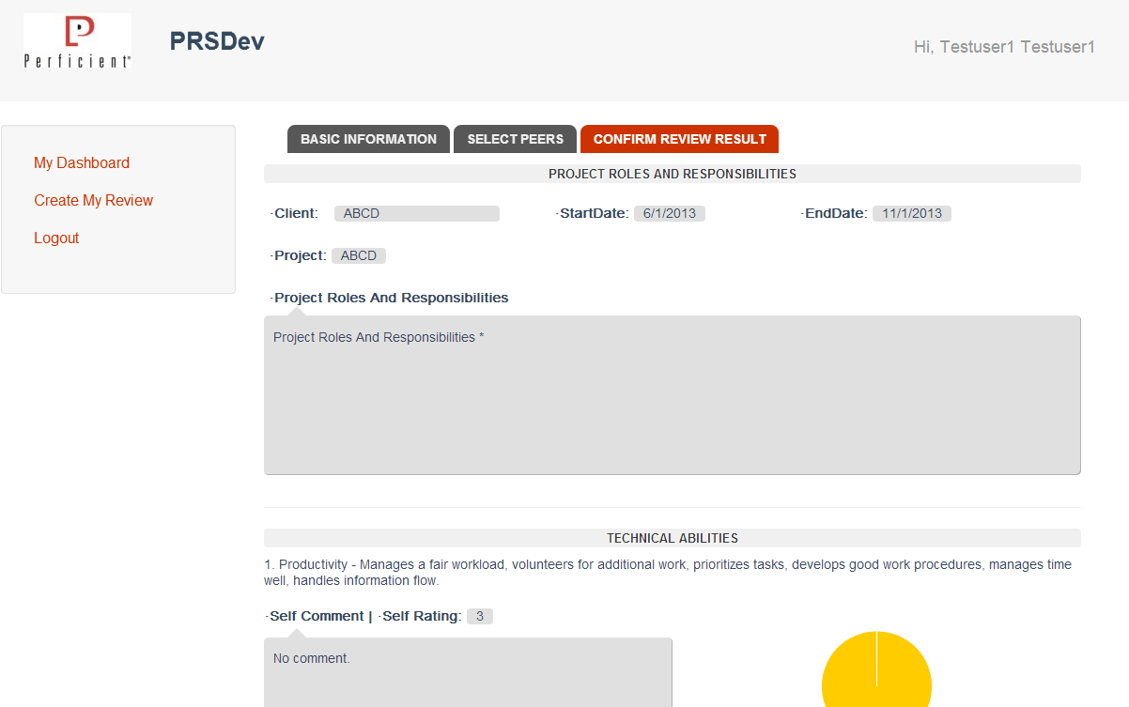

Slide 22
Welcome, John Spyers
Logout
My Dashboard | Work a Review | Completed Reviews
Review Details
Peer Review Info
Review Details
>> Summary
>> Previous Year Goals and Achievements
>> Performance Evaluation
>> Planning Goals
>> Finalize
Review Details - Summary
My Information
Review Type: Annual
Name: First Last
Period: To -- From
Project Roles and Responsibilities
Client: client
Project Name: project
Start Date: 06/2013
End Date: 10/2013
Project Manager: blah blah blah
Lead Analyst: blah blah blah
+ Add Another Project
Next

Slide 23
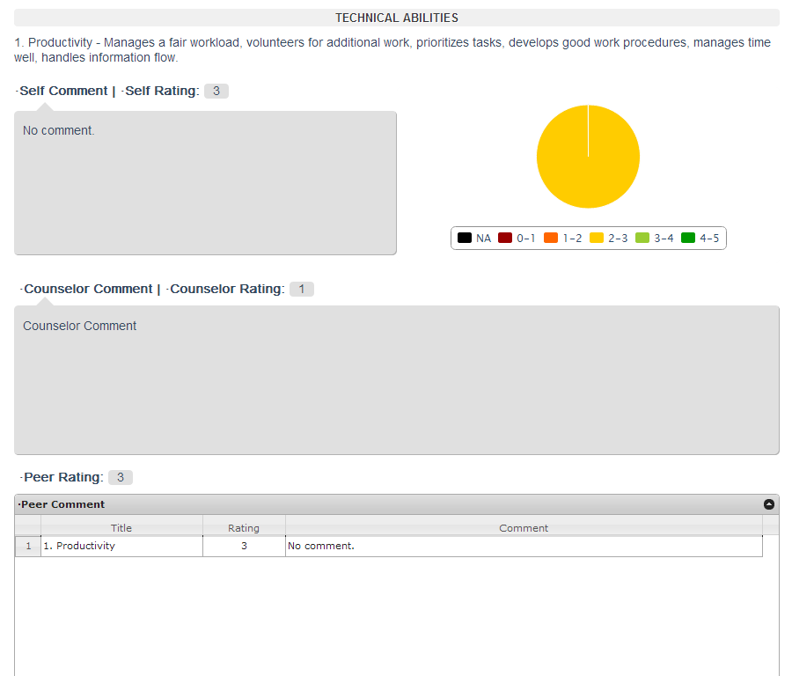

Slide 24
Welcome, John Spyers
Logout
My Dashboard | Work a Review | Completed Reviews
Review Details
Peer Review Info
Review Details
>> Summary
>> Previous Year Goals and Achievements
>> Performance Evaluation
>> Planning Goals
>> Finalize
- Technical Abilities (allow expand/collapse at this level)
- Productivity – Manages a fair workload, volunteers for additional work, prioritizes… (allow expand/collapse at this level)
Self Rating: 4 Counselor Rating: <<entry field>>
Comments: Comments:
Peer Rating: Show Feedback Chart
I did a lot of hard work
Joe really didn’t do anything
Peer feedback table

Slide 25
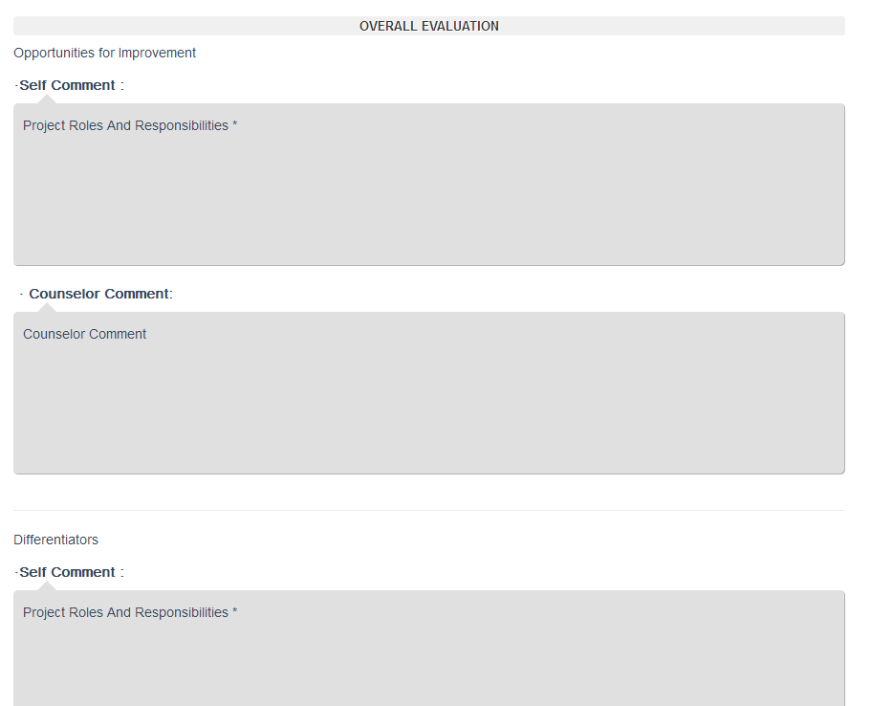

Slide 26
Welcome, John Spyers
Logout
My Dashboard | Work a Review | Completed Reviews
Review Details
Peer Review Info
Review Details
>> Summary
>> Previous Year Goals and Achievements
>> Performance Evaluation
>> Planning Goals
>> Finalize
- Overall Evaluation(allow expand/collapse at this level)
- Opportunities for Improvement (allow expand/collapse at this level)
Self Comments: Counselor Comments:
- Differentiators (allow expand/collapse at this level)
Self Comments: Counselor Comments:
I could stop procrastinating
Joe should really work on his Excel skills.
I’m good at surfing the internet and finding funny pictures of cats.
Joe is the best user of Google that I have ever met.

Slide 27
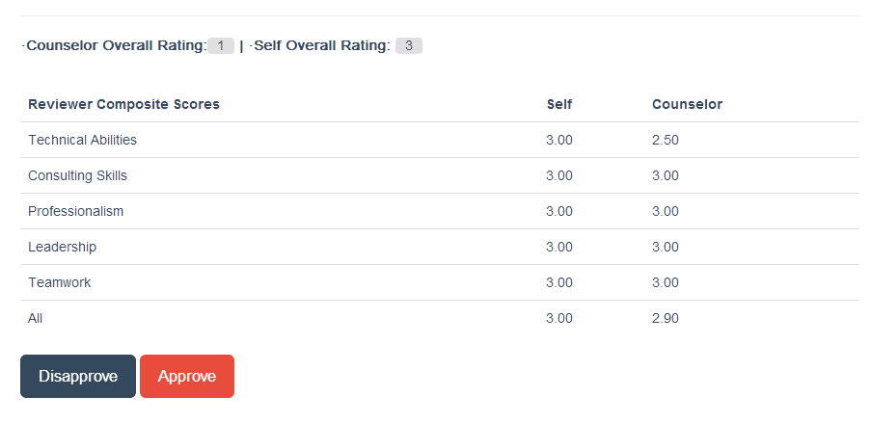

Slide 29
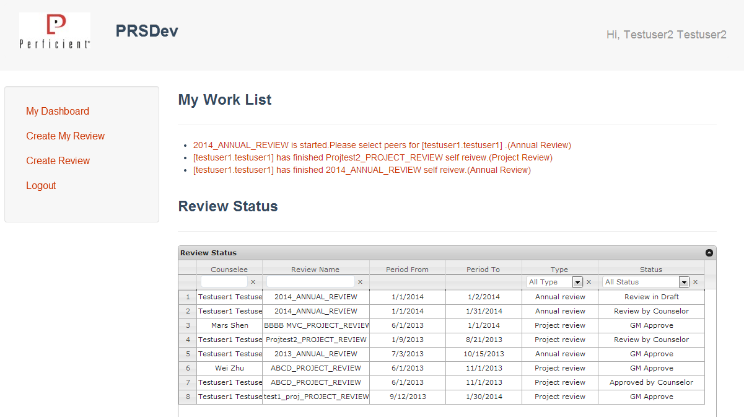

Slide 30
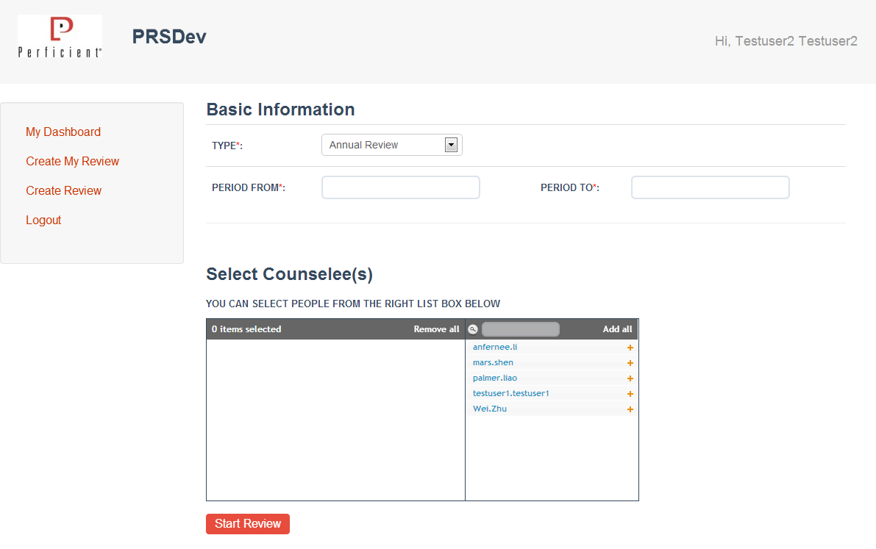

Slide 31
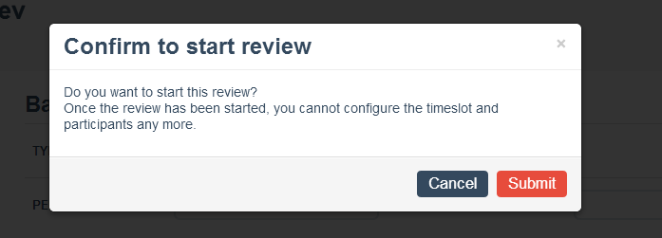

Slide 32
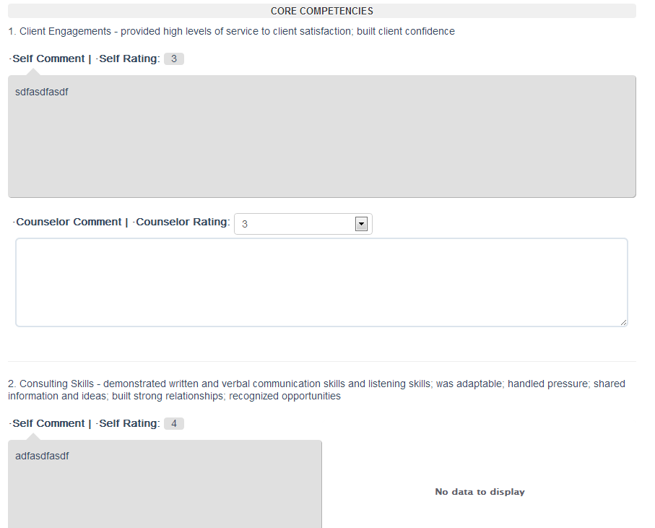

Slide 33
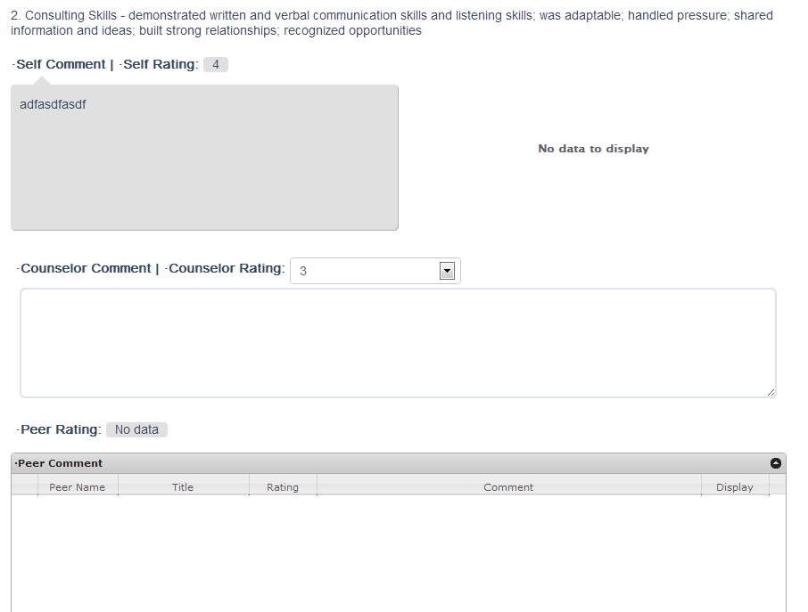

Slide 34
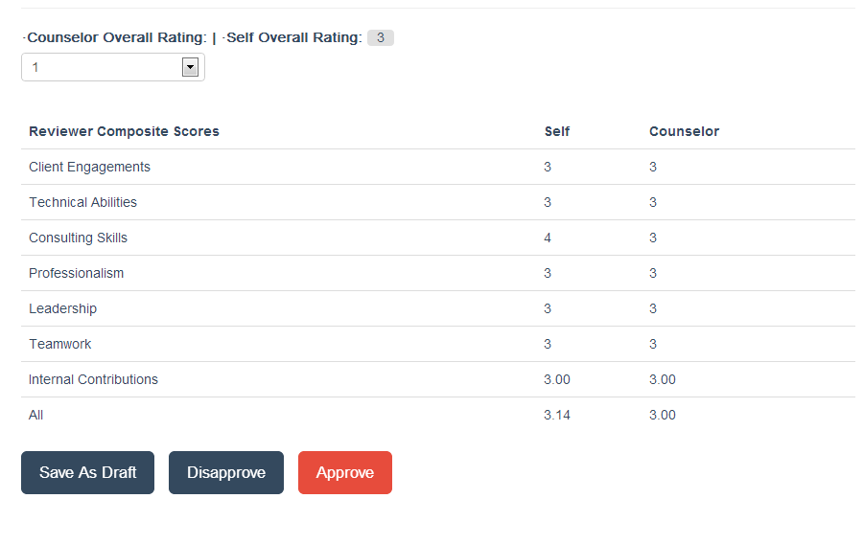

Slide 35
